Slide 1
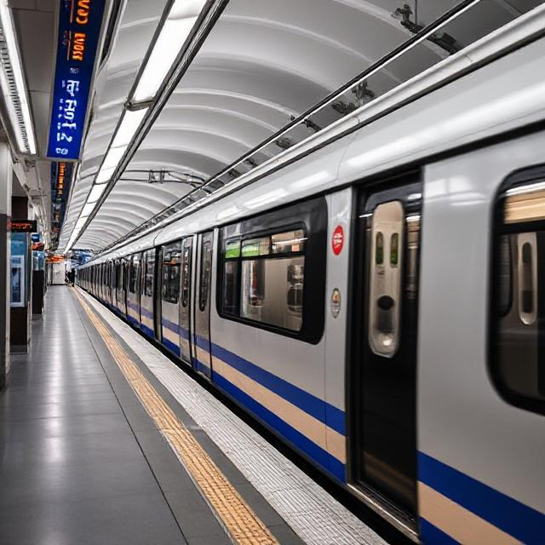
Metro Routing
Using Dijkstra's Algorithm for Efficient Navigation

Slide 2
Introduction
“In today’s fast-paced world, finding the quickest metro route can save both time and energy. This presentation explores Dijkstra's Algorithm, breaking down its simple yet powerful principles that help identify the shortest paths between metro stations. We’ll walk through how it works in real-time, showing how it processes station connections and minimizes travel time. By the end, you'll see how this algorithm transforms everyday metro travel, making commuting smoother and more efficient.’’

Slide 3
01
Algorithm Overview
void findShortestRoute(string src, string dest) {
// Check for invalid stations
if (metroGraph.find(src) == metroGraph.end() || metroGraph.find(dest) == metroGraph.end()) {
cout << "Invalid stations! Please enter valid station names.\n";
return;
}
// Initialize distance and parent maps
map<string, double> distance;
map<string, string> parent;
priority_queue<pair<double, string>, vector<pair<double, string>>, greater<pair<double, string>>> pq;
for (auto &station : metroGraph) {
distance[station.first] = numeric_limits<double>::max(); // Infinity for all
}
// Start from the source station
distance[src] = 0;
pq.push({0, src});
while (!pq.empty()) {
string current = pq.top().second;
pq.pop();
// Explore neighbors
for (auto &neighbor : metroGraph[current]) {
string nextStation = neighbor.first;
double weight = neighbor.second;
// Relaxation step
if (distance[current] + weight < distance[nextStation]) {
distance[nextStation] = distance[current] + weight;
pq.push({distance[nextStation], nextStation});
parent[nextStation] = current;
}
}
}
// Print the shortest path
cout << "\nShortest route: ";
vector<string> path;
cout << endl;
}

Slide 4
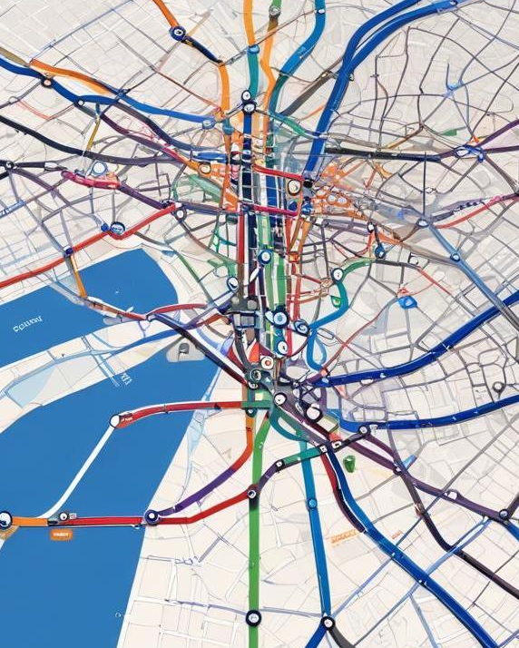
What is Dijkstra's Algorithm?
Dijkstra's Algorithm is a smart and reliable method used to find the shortest path between locations in a network. Imagine navigating through a city’s metro system the algorithm starts from one station and explores all possible routes to reach other stations, always choosing the path with the least travel time or distance. Since it works perfectly with positive route distances, it’s ideal for planning efficient metro journeys and reducing travel

Slide 5
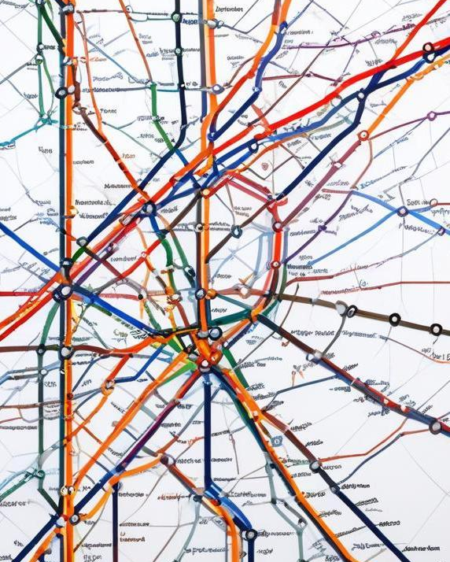
Graph representation of metro lines
In implementing Dijkstra's Algorithm for metro routing, metro lines can be represented as a graph where stations are nodes and the connections between them are edges weighted by travel time or distance. This representation allows the algorithm to calculate the most efficient routes through the network.

Slide 6
This map displays the metro route between Miyapur and Dilsukhnagar, covering multiple stations along two main metro lines:
Red Line (Horizontal Line): Miyapur to Assembly with distances marked between stations.
Blue Line (Vertical Line): ESI Hospital to Dilsukhnagar, intersecting at ESI Hospital.
Ideal for planning optimal metro routes.
Can be used for shortest route calculation in metro navigation systems.

Slide 7
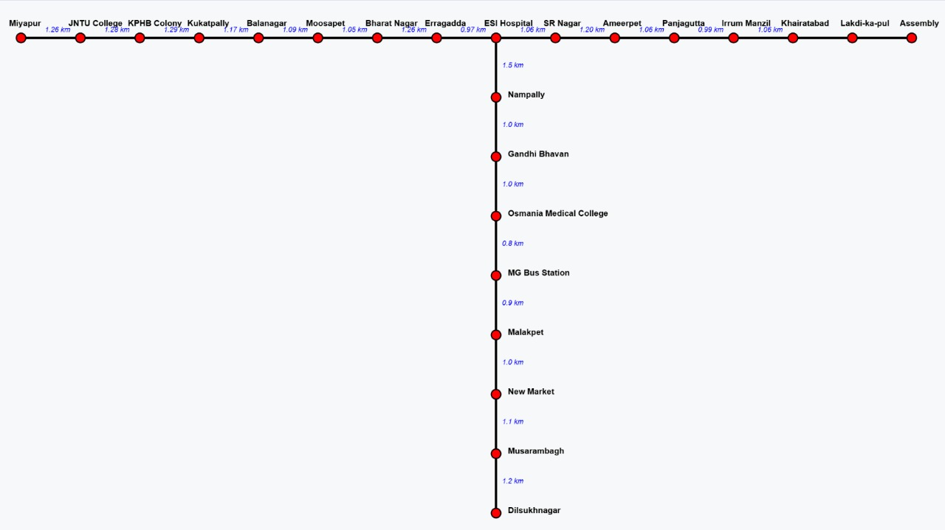

Slide 8
Finding the shortest route
The core function of Dijkstra's Algorithm in metro systems is to find the shortest route from the starting station to the destination. By evaluating the weighted connections and selecting the path with the lowest total weight, the algorithm efficiently determines the best travel options for users.

Slide 9
Conclusions
Dijkstra's Algorithm proves to be a fundamental tool in optimizing metro routing systems, allowing for quick and efficient route planning that enhances user experience. By continually integrating real-time data, metro systems can adapt to changing conditions, ensuring reliable transportation.

Slide 10
THANK YOU!
TEAM MEMBERS :
T.YASHWANTH REDDY(RA2311030010317)
L.KOUSHIK (RA2311030010283)

